Slide 1
CONVEYOR AND TRANSMISSION BELTS
VISHAL V. NIKAM
MRUNMAYI N. BANDEKAR
SHEETAL S. MISAL

Slide 2
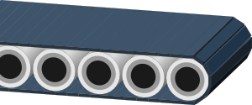
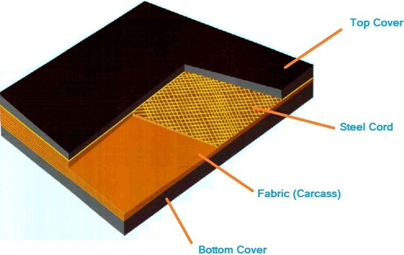
Introduction
Conveyor belts generally are composed of three main components:
1. Carcass
2. Skims
3. Covers

Slide 3
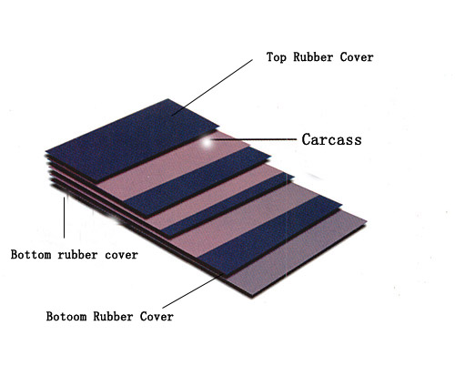
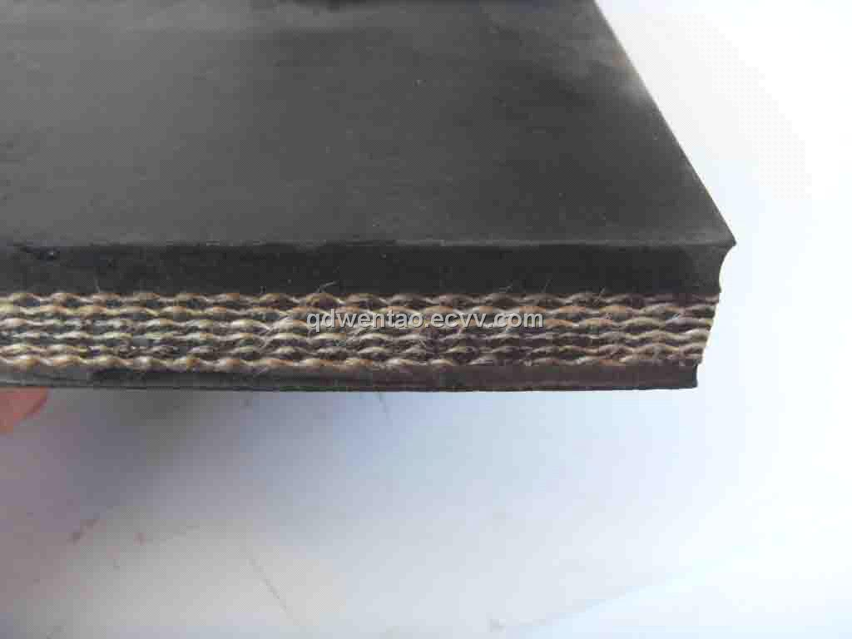
Types of conveyor belts
Single ply conveyor belt
Multi-ply conveyor belt

Slide 4
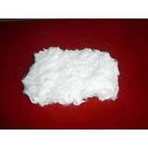
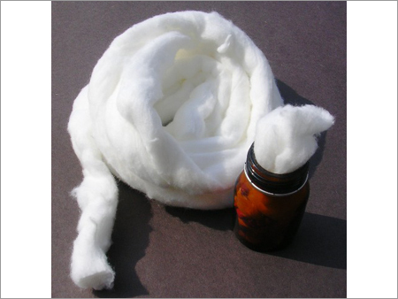
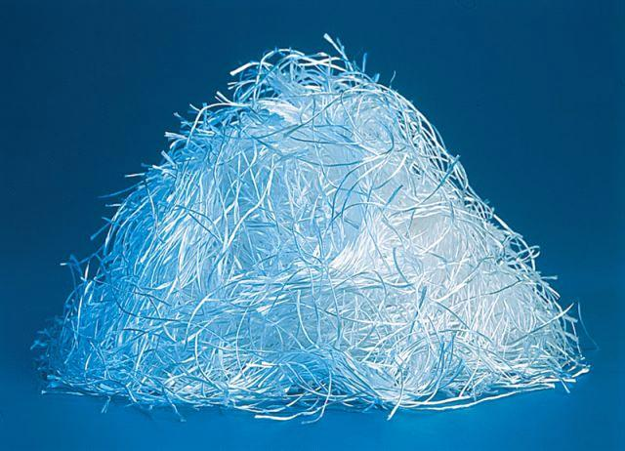
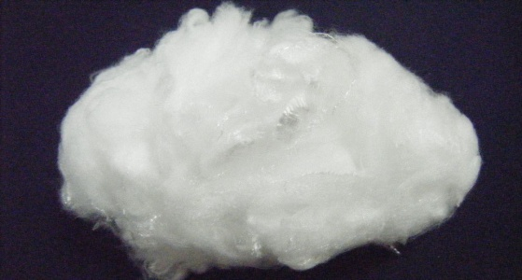
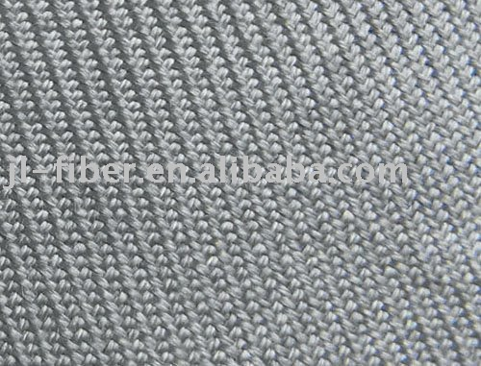
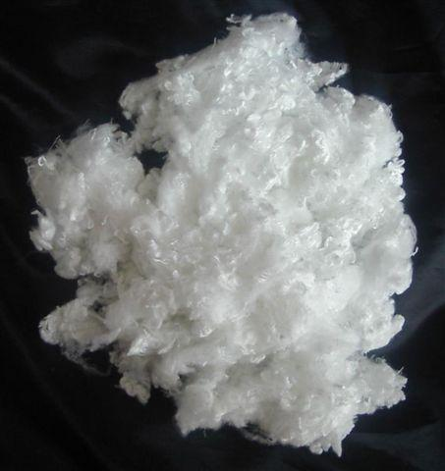
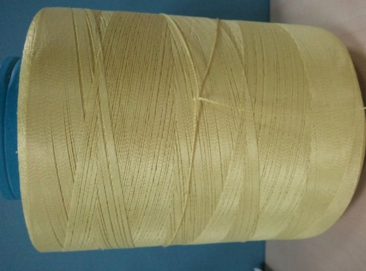
Fibers used in belts
Cotton
Rayon
Glass
Nylon
Polyester
Steel
Kevlar

Slide 5
Properties required for ideal belts
High Strength,
Low self weight,
Small specific elongation,
High Flexibility,
High resistivity to ply separation
Low hygroscopic
Long service life

Slide 6
Transmission belts
Types of belts:
Flat belt
V-Belt
Ropes

Slide 7
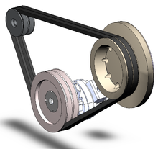
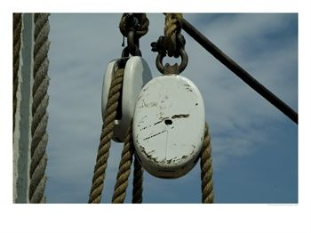
Features and usages

Slide 8
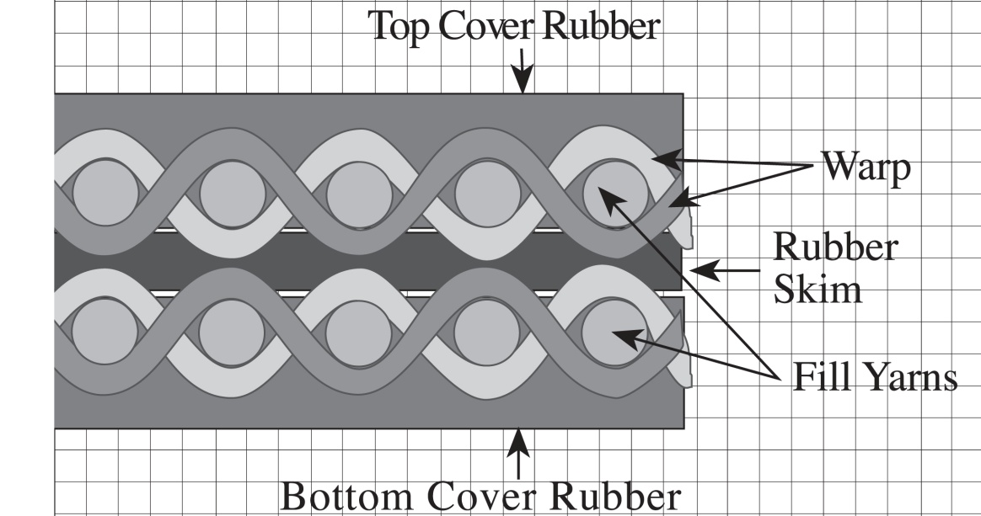
Belt Construction
Conveyor belt is made up of 3 layers:
Carcass
Skim
Covers

Slide 9
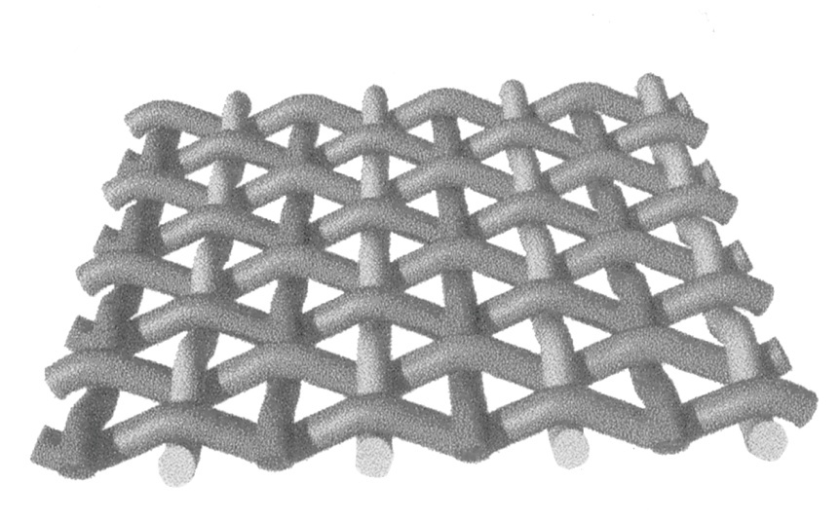
Carcass
Reinforcement inside the conveyor belt
Rating by the max. operating tension
Weave is used in fabric construction

Slide 10
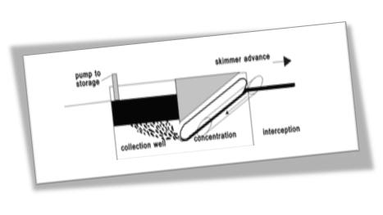
Skims
Rubber, PVC or urethane layers
It has imp contribution
Improper or marginal skims

Slide 11
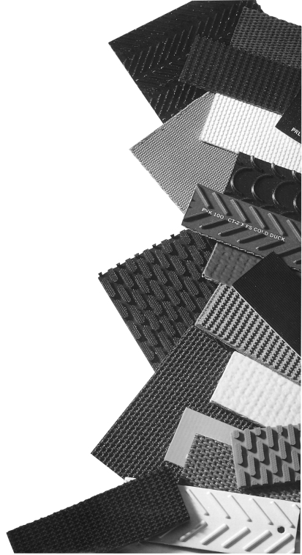
Covers
In order to protect carcass
Increases its desirable properties
Life of belt depend on cover
Material used for cover
Cover is of two layers

Slide 12
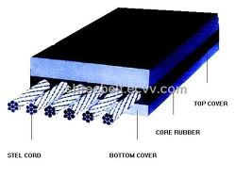
Steel
Two layers
steel cord
Strenght
Elongation

Slide 13
Manufacturing
Drying of fabric
Frictioning & Topping
Belt building
Vulcunisation

Slide 14
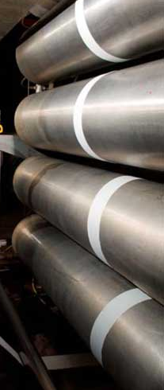
Drying of fabric
To avoid blowing of laminates
Passage of fabric
Steam heated roller
Speed-15m/min
Temperature-115°c
Moistue level-1%

Slide 15
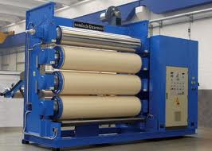
Frictioning & Topping
Fabric should be hot
3 or 4 bowl rubber calender
Light weight fabrics- friction coated
Heavier fabrics- topped or skim coated

Slide 16
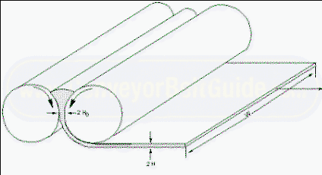
CALENDERING AND COATING
OVER HERE 3 ROLLES REVOLVE IN OPPOSITE DIRECTIONS DUE TO WHICH THE RUBBER IS PRESSED TO THE CONVEYOR BELT FABRIC

Slide 17
BUILDING:
A CONVEYOR BELT CONSISTS OF NUMBER OF TEXTILE PLIES AND COVER ON BOTH THE SIDES.
BUILDING TABLE PROCESSES NOS. OF STATIONS WHERE THE FABRIC ROLLS ARE LOADED. CARCASS IS THEN BUILT BY LAMINATING THE OTHER REQUIRED PLIES.
AFTER BUILDING THE BELT IS PASSED THROUGH DUSTING POWDER WHICH ACTS AS A SEPARATOR.

Slide 18
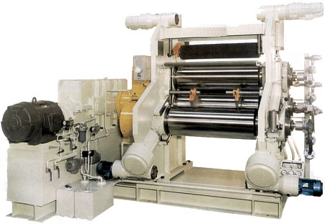
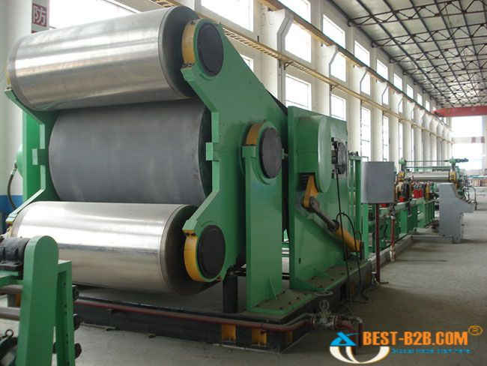
VULCANISATION
VULCANIZATION / CURING:
A chemical process for converting rubber or related polymers into more durable materials via the addition of sulfur or other equivalent "curatives."
Done either by a press or a continous drum curing machine

Slide 19
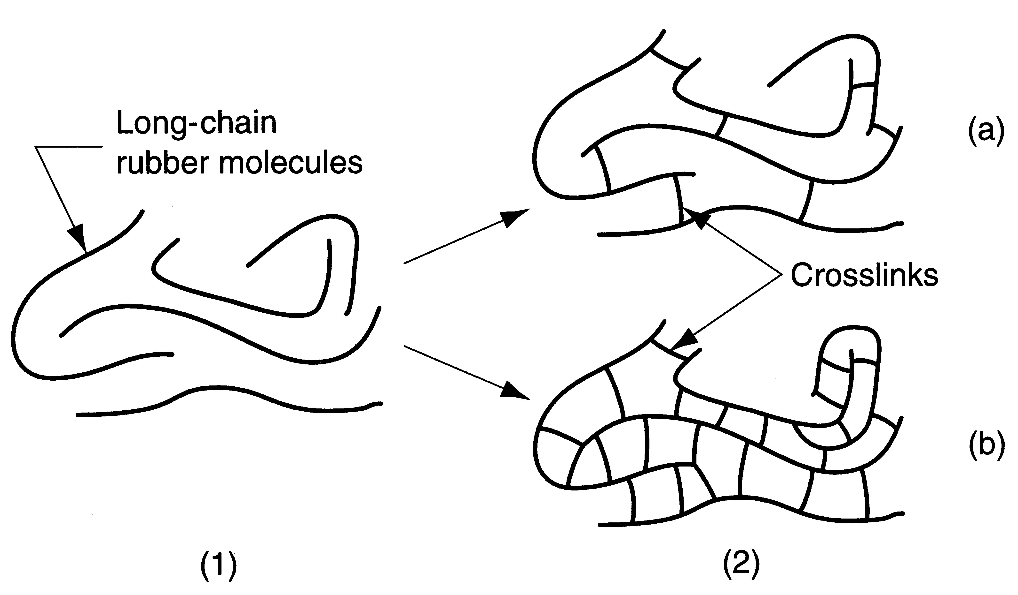
Effect of Vulcanisation
Figure ‑ Effect of vulcanization on rubber molecules: (1) raw rubber, and (2) vulcanized (cross ‑linked ) rubber. Variations of (2) include: (a) soft rubber, low degree of cross‑ linking; and (b) hard rubber, high degree of cross ‑ linking
Vulcanized materials are less sticky and have superior mechanical properties.

Slide 20
MARKET FORECAST
Market forecasts show the long term outlook & trends for Belt Manufacturing.
highly demanded in the market.
Belt manufactures responded with product that confirm to new size and weight demands of automotive market

Slide 21
COSTING
PRODUCT
Plastic mesh conveyor belt
Rubber conveyor belt
COST
US $10-500/Meter
US $30-120/Meter
Transmission rubber conveyor belt
US $1-100/Meter
Coal mine conveyor belt
US $1-10000/Roll
Oil resistant conveyor belt
US $1-100/Meter

Slide 22
SCOPE
FUTURE MARKET POTENTIAL OF CONVEYOR & TRANSMISSION BELTS IS LINKED TO NEW PROJECTS LIKELY TO BE SET UP OR EXPANSION OF THE EXISTING PROJECTS.
THE MARKET FOR CONVEYOR BELT IS EXPECTED TO INCREASE AT THE RATE OF 5-10% PER ANNUM INCLUDING THE REPLACEMENT MARKET. ACCORDINGLY, THE MARKET POTENTIAL FOR CONVEYOR BELTS ESTIMATED TO INCREASE.

Slide 23
THANK YOU

