Slide 1
FILTERATION OF FABRICS
NAME OF STUDENTS
Manali Kolekar -084051126
Rupesh Jadhav-084050017
Atish Mohite-084050030

Slide 2
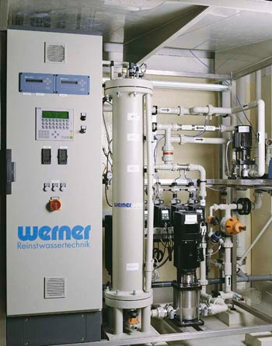
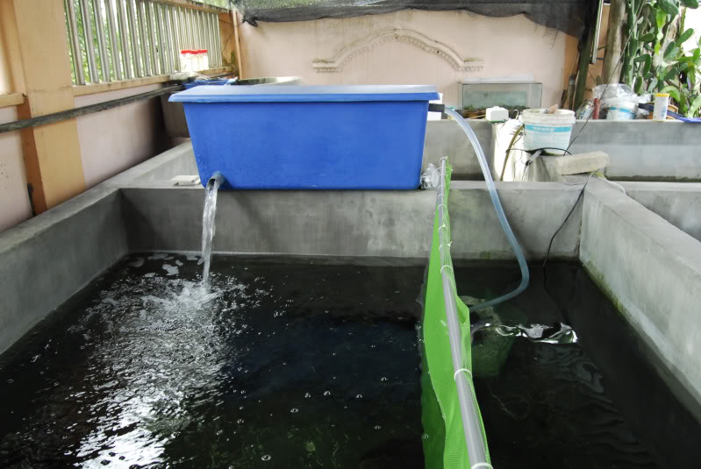
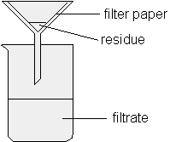
INTRODUCTION
Filtration
Filtration means capture and retention of small particles from a moving stream either from gas or liquid , with minimum resistant to flow.
2. The fibers used in filtration fabrics are polypropylene , cotton, wool, PTFE , polyester.

Slide 3
Types of Filtration Operations
· Cross-flow filtration, in which a septum is
responsible for the filtering action (e.g.,
micro screens);
· Depth (or deep-bed) filtration, in which the
particles are removed throughout the filter
bed or in a significant portion of it (e.g.,
sand filters);
· Cake filtration, in which the particles are
removed on the surface of a cake formed
by the solids accumulating on a septum
(e.g., rotary vacuum filters)

Slide 4
Classification of Filtration Systems
Filtration systems can be classified according to:
• type of operation
• direction of fluid flow with respect of filter medium
• type of filter (medium)
• flow rate or pressure control during filtration

Slide 5
MAIN CHARACTERISTICS
1. clear filtrate
2. high capacity
3. low cake moisture content
4. long life time.
5. Porosity
6. Good flexibility

Slide 6
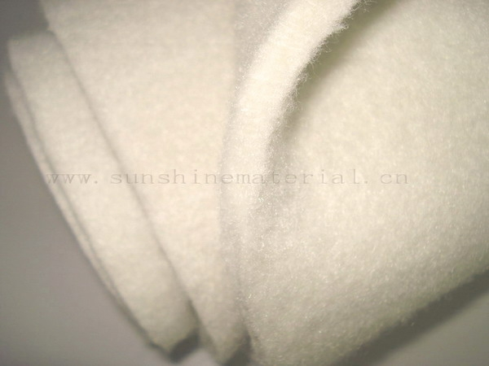
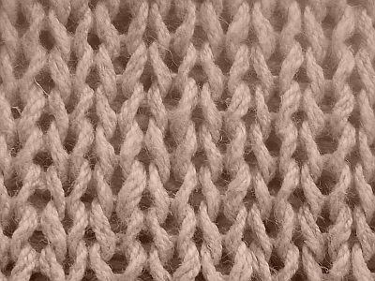
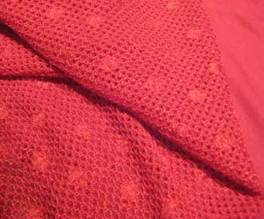
There are 3 main types of filtration:
dry filtration(solid-gas)
wet filtration(solid-liquid)
gas plasma filtration
FABRIC CONSTRUCTION
Woven
Knitted
Nonwoven

Slide 7
Fibers for dry filter manufacture are:-
Glass fibers
Standard synthetic fibers
Nomex
PET
PP
cellulosic fibers (viscose & cotton)
nylon
PTFE (Teflon),microfibers
mineral fibers
high tech fibers (e.g. PEEK), etc.

Slide 8
Fibers For liquid filtration manufacture:-
PP, PE, PET, NYLON 11,12, polyamide, PTFE, PEEK, cotton,
Yarn is usually monofilament, multifilament, fibrillated tape or staple fiber yarn in type.
Nomex fibers are widely used for fabric filter bags.

Slide 9
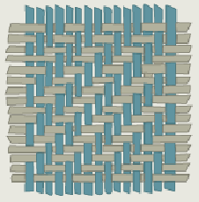
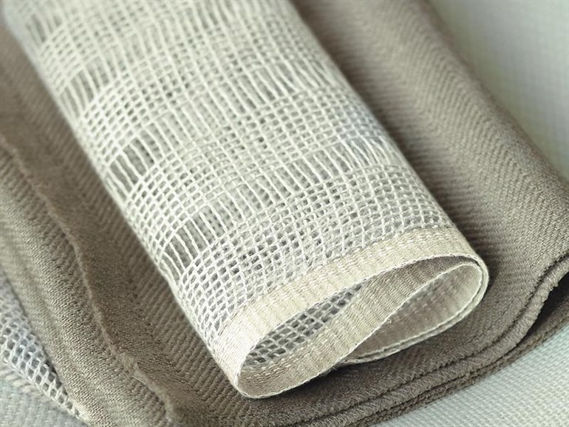
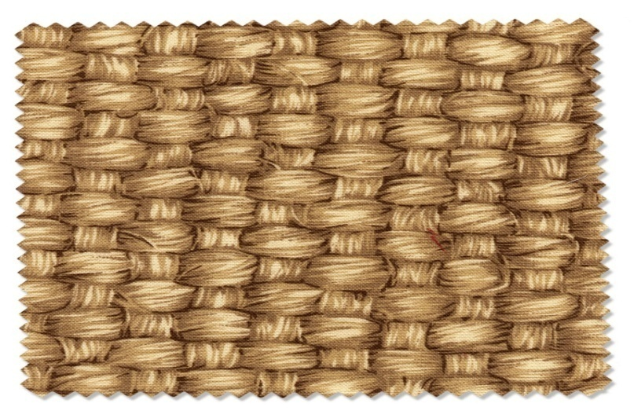
FILTER CLOTH WEAVE PATTERNS (Cloth Designs)
Plain
Twill
Satin
Leno
Basket

Slide 10
Technologies used for manufacturing non-woven for filter fabrics -
Air laid
Electro spun
Melt blown
Needlepunch
Spun bond
Spun lace
Thermo bonded
Wetland

Slide 11
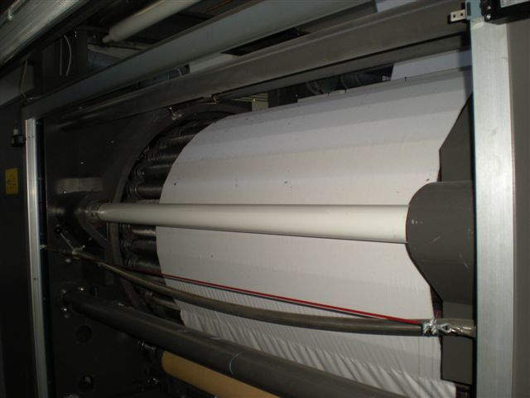
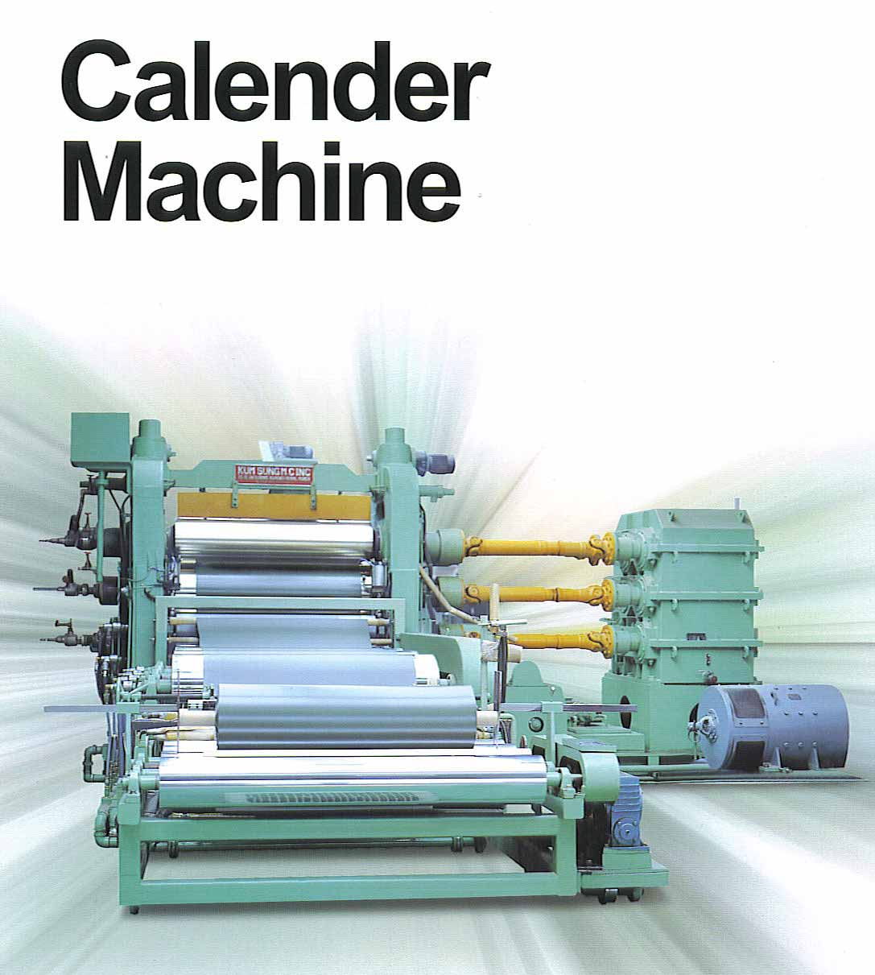
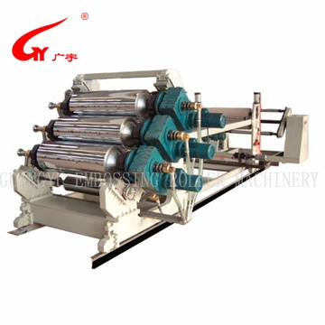
Pretreatment processes
Calendering
Napping
Singeing
Glazing
Coating

Slide 12
Types of Finishes given
Thermal Treatment | Chemical Treatment
Heat setting | Anti-adhesive
calendering | hydrophobe
Singeing | Oleophobe
condensing | Antistatic
 | Anti-flammable
 | Chemical resistance

Slide 13
Tests for Filter fabrics
General QC Tests
Performance related tests .

Slide 14
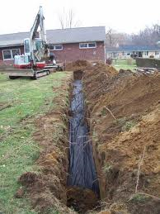
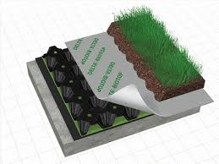
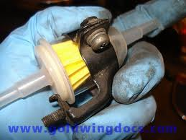
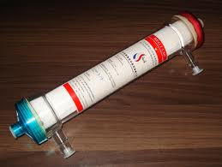
Application of filter fabrics
Geotech
Indutech
Meditech
Agrotech
Mobitech

Slide 15
Cost of filter fabric
Type of fabric | Cost in US $
PP fabric | 1-6 per sq.m
For road construction | 0.3-0.6 per sq.m
Polyester fabric with PTFE membrane | 1.43-2.4 per sq.m
Non woven for air filters fabric | 1-10 per roll
Glass fibers filter fabric | 1-10 per piece
Stain less steel filter fabric | 1-20 per sq.m
Needle felt fabric | 2-3 per sq.m
Anti-static filter fabric | 2-20 per sq.m

Slide 16
Market of filter fabric
Worldwide market is $6 billions in 2012
Biggest purchaser is china
Filter fabrics most used in geotech
Polyester and nylon most commonly used
Polypropylene, polyethylene, E-CTFE and PVDF respectively

Slide 17
THANK YOU

