Slide 1
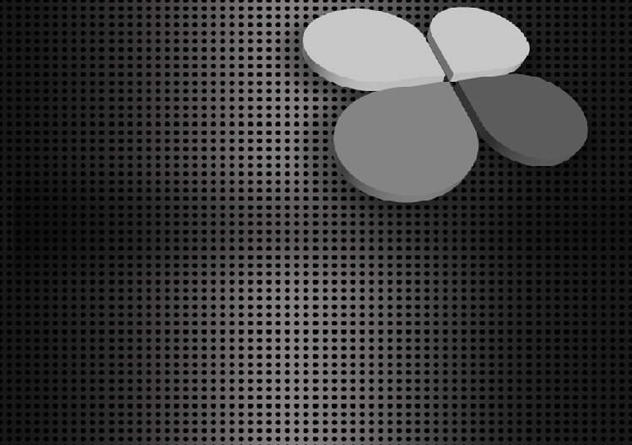
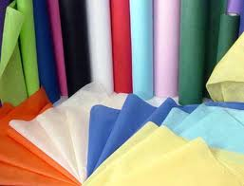
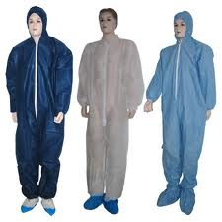
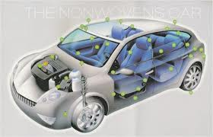
NON-WOVEN
Sudipto P. Mandal 084050254.

Slide 2
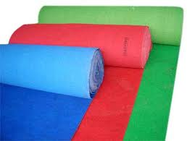
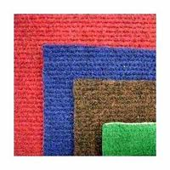
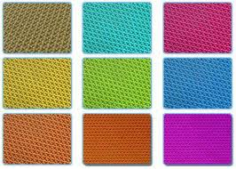
Defination of Non-Wovens
“A nonwoven is a sheet of fibres, continuous filaments, or chopped yarns of any nature or origin, that have been formed into a web by any means, and bonded together by any means, with the exception of weaving or knitting.”

Slide 3
History of Non-Wovens
Were first made from fibrous waste.
Technical & marketing mistakes.
Were first assumed as cheap substitutes.
They were considered as low quality items.
In 1960s were first used as am application in manufacturing bandages.
Later became an important part of technical textile.
Notes:
3
3

Slide 4
INTRODUCTION TO NON-WOVEN
Nonwoven fabric is a fabric-like material made from long fibers, bonded together by chemical, mechanical, heat or solvent treatment.
Nonwoven fabrics are broadly defined as sheet or web structures bonded together by entangling fibre or filaments (and by perforating films) mechanically, thermally or chemically.
They are not made by weaving or knitting and do not require converting the fibres to yarn.
The term is used in the textile manufacturing industry to denote fabrics, such as felt, which are neither woven nor knitted.
They are flat, porous sheets that are made directly from separate fibres or from molten plastic or plastic film. They are not made by weaving or knitting and do not require converting the fibres to yarn.

Slide 5
ADVANTAGES OF NON-WOVEN
The great advantages in non-woven fabrics is the speed with which the final fabric is produced.
All yarn preparation steps are eliminated, and the fabric production itself is faster than conventional methods.
To produce 500,000 meters of woven sheeting requires 2 months of yarn preparation, 3 months of weaving on 50 looms and 1 month for finishing and inspection.
Non-woven fabric can deliver the same quantity of sheeting within 2 months from order.
Not only are production rate are higher for nonwovens, but the process is more automated, requiring less labour than even most modern knitting or weaving systems.
The nonwoven process is also efficient in its use of energy.

Slide 6
Applications
Nonwoven fabrics can be engineered to give a wide variety of properties.
Nevertheless, their aesthetic properties (handle, drape, appearance) are such that they are not in direct competition with conventional fabrics in the outerwear market.
Woven and knitted fabrics will not be replaced by nonwovens in the near future.
Currently, the main areas of growth in nonwovens are in Geotextile, medical and hospital uses, disposable products and filters.

Slide 7
Raw-Material Used for Non-Wovens
Cotton
Viscose
Polyester
Polypropylene
Polyamide
Glass fibers
Standard synthetic fibers
Nomex
cellulosic fibers (viscose & cotton)
Nylon
PTFE (Teflon),microfibers
Mineral fibers
High tech fibers (e.g. PEEK), etc.

Slide 8
Production Rate
Fabric production method | Rate of fabric production
Weaving | 1 metre/minute
Knitting | 2 metre/minute
Nonwoven | 100 metre/minute

Slide 9
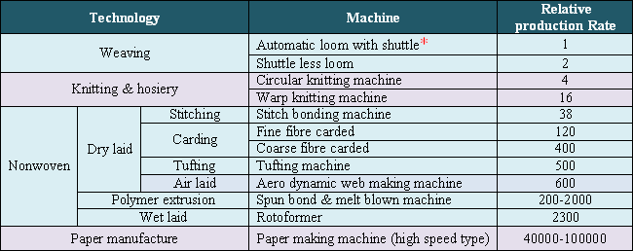
Comparison between different rates of production in the manufacture of textiles & similar materials

Slide 10
Market share of different web laying process
WEB LAYING PROCESS | PERCENTAGE SHARE (%)
Dry laid | 44
Airlaid | 3
Polymer Extrusion | 37
Wet laid | 16

Slide 11
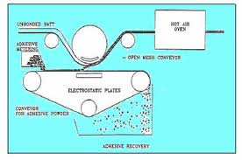
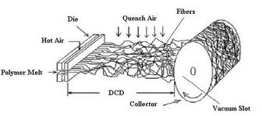
Manufacturing Process of Non-Wovens
There are normally two steps for making non-woven products.
1 Web formation 2 Bonding systems.

Slide 12
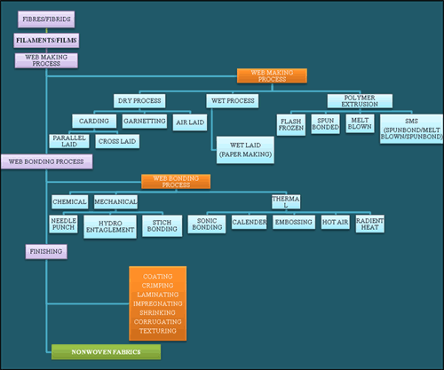
Process flowchart for producing nonwoven

Slide 13
Web Formation Methods
A nonwoven fabric is basically a web of fibres held together in some way.
The web may be made of staple fibres or filaments, or from portions of polymer film.
Web formation from Staple Fibres
Parallel-laid web from carded fibres.
Cross Laid-web.
Random web.
Other Web formation methods
Dry Laid.
Wet Laid
Spun Melt.
Electrostatic web formation.
Spraying.

Slide 14
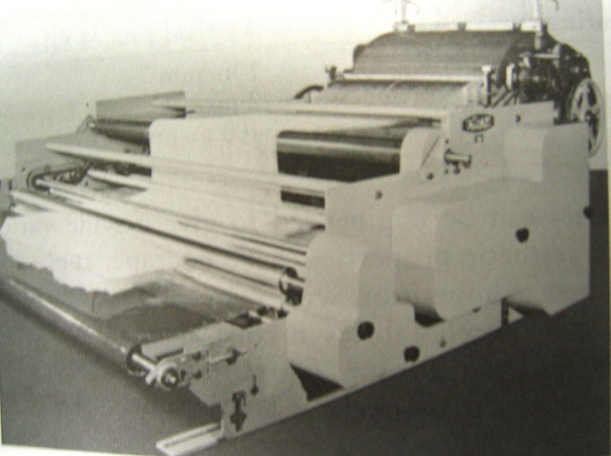
Web formation from Staple Fibres
1. Parallel-laid web from carded fibres.
Carding is a time-honored way of making web from staple fibres.
In a carded web the fibres are aligned more or less parallel to each other and to the direction in which the card produces the web.
Such web is stronger when pulled lengthwise than crosswise because there is more friction between the fibre in lengthwise direction.
Carded webs are usually thin, they may be too thin for some nonwoven end-uses. To increase the final thickness, a number of webs can be layered.

Slide 15
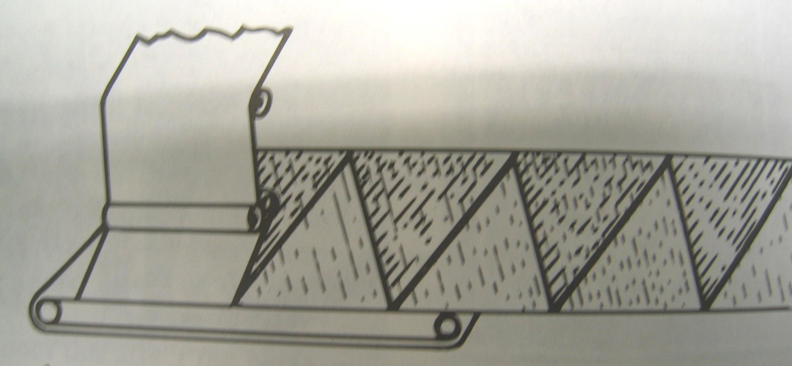
Web formation from Staple Fibres
2. Cross Laid-web
To increase the strength of web in both lengthwise and crosswise directions, cross laid web is used.
To achieve this, the fibres which make up the web will be orientated equally in both lengthwise and crosswise directions.
The properties of cross-laid webs do not vary with direction as much as do those of straight-laid web

Slide 16
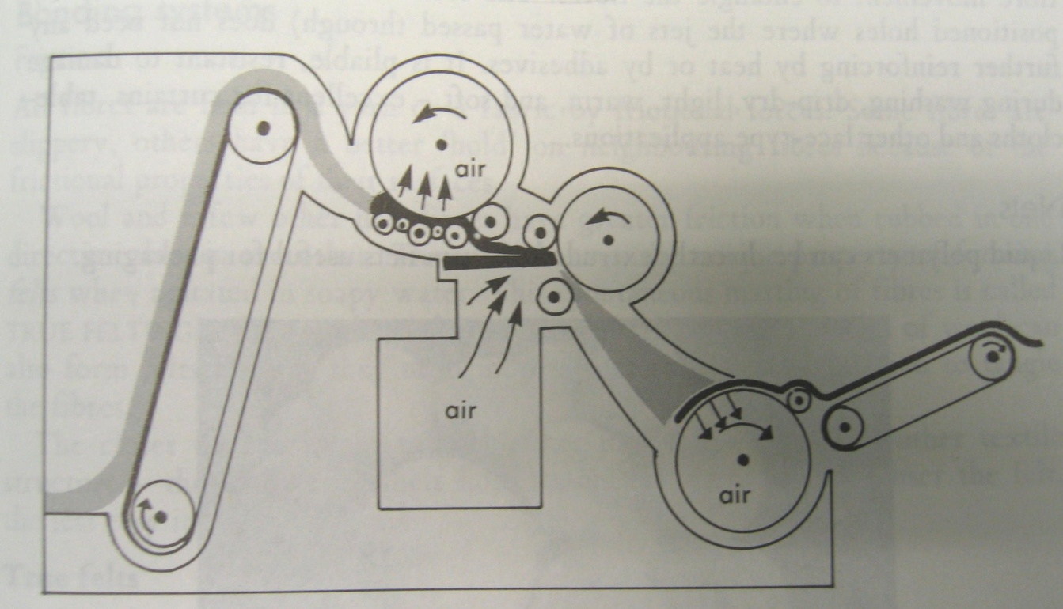
Web formation from Staple Fibres
3. Random web.
The Rando-Webber creates such a randomly orientated web by blowing the fibres about in a stream of air and then sucking them onto the surface of a perforated drum to form a layer.
This randomizing process produces a remarkably uniform web from staple fibres and with no directionality in properties.
Its webs account for three-quarters of non-woven produced

Slide 17
Other Web formation methods
1. Dry Laid.
There are two methods of dry laying:
a) Carding.
b) Air laying.
Carding machine
It is a revolving drum or series of drums covered in fine metallic wires or teeth.
Carding is a mechanical process starting with the opening of fibre bales which are blended and conveyed to the next stage by air transport.
They are after that combed into a web by a carding machine.
The exact configuration of cards depends on the fabric weight and fibre properties needed.
The web can be parallel-laid, or can be random-laid.
The parallel-laid carded webs result in
Good tensile strength,
Low elongation and
Low tear strength
in the machine direction and the reverse in the cross direction.

Slide 18
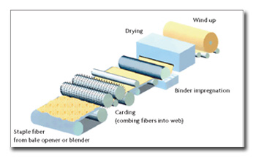
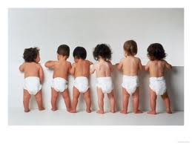
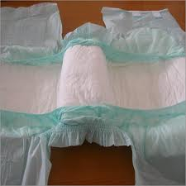
Other Web formation methods
1. Dry Laid.

Slide 19
Other Web formation methods
1. Dry Laid.
Air laying:
Generally tiny fibres are fed into an air flow.
From here it goes on to a moving belt or perforated drum, where they form a randomly oriented web.
Air laid webs gives greater adaptability in terms of the fibres and fibre blends that can be used.
Compared with carded webs, air laid webs has lower density, greater softness and the laminar structure is absent.

Slide 20
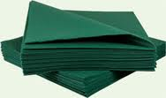
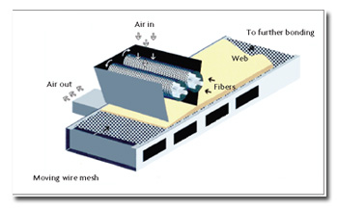
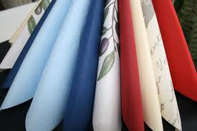
Other Web formation methods
1. Dry Laid.
Air laying:

Slide 21
Other Web formation methods
2. Wet Laid.
The method of wet laying is similar to paper manufacturing but with synthetic fibres.
Dilute slurry of water and fibres is dumped on a moving wire screen and drained to form a web.
After that with the help of pressing between rollers the web is dewatered, consolidated and then dried out. Impregnation with binders is frequently integrated in a later phase of the progression.

Slide 22
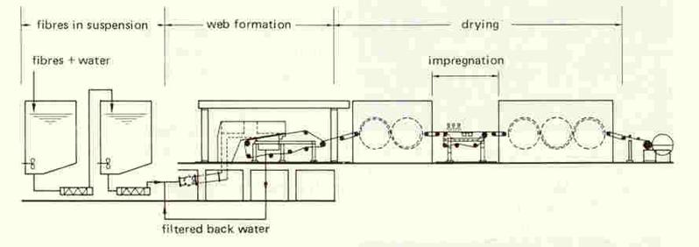
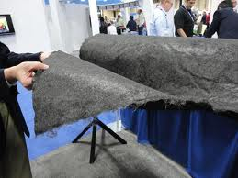
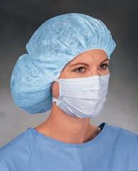
Other Web formation methods
2. Wet Laid.

Slide 23
Other Web formation methods
3. Spun Melt.
Spun melt is a generic term describing the manufacturing of nonwoven webs directly from thermoplastic polymers. It consists of two processes:
a) Spun laid
b) Melt blown
Spun laid process
Also known as spun bonded.
Polymer granules are melted and then the molten polymer is extruded throughout spinnerets.
Then the continuous filaments are chilled and dump on to a conveyor belt to structure a uniform web.
In the spun laid method, the raw material elasticity is more controlled; however it gives the nonwovens superior strength. Co-extrusion of second components is used in numerous spun laid methods, generally to provide extra properties or bonding potential.

Slide 24
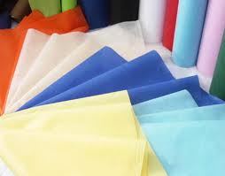
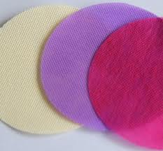
Other Web formation methods
3. Spun Melt.
Melt blown
In melt blown process web is formed by comparatively low viscosity polymers which are extruded into a high velocity air stream.
This distributes the melt, solidifies it and breaks it up into a fibrous web.

Slide 25
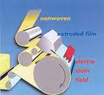
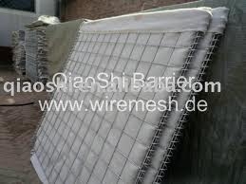
Other Web formation methods
4. Electrostatic web formation.
.
In electrostatic laying, fine fibres are given a static electric charge between the plates of a condenser.
They are then allowed to fall on a moving belt to form a randomly orientated but uniform web.
As specified above specialize technology the most important is the electrostatic spinning, where mainly fibrillation takes place to form the web.

Slide 26
Other Web formation methods
5. Spraying.
.
Short thermoplastic fibres can be SPRAYED onto a belt to produce a random web.
The are subsequently fused by the application of heat and pressure.
***

Slide 27
Web Bonding Methods
As soon as the web is formed it has a little strength which doesn’t match the requirement of the customers. So it becomes very necessary to bond the web & for that method many choice are available.
The main criterion of choice of any web bonding technology entirely depends on the functional properties.
There are three basic types of bonding:
a) Chemical
b) Thermal
c) Mechanical
CHEMICAL
BONDING
THERMAL BONDING
MECHANICAL BONDING

Slide 28
Web Bonding Methods
A) Chemical bonding
In chemical bonding normally web is bonded with the help of some binding agent generally refer as binder.
Three groups of materials are commonly used as binders:
Acrylate polymers and copolymers
Styrene-butadiene copolymers
Vinyl acetate ethylene copolymers.
The method of applying binder are
Impregnating
Coating
Spraying
The binders should necessary to apply homogeneously for better property gaining

Slide 29
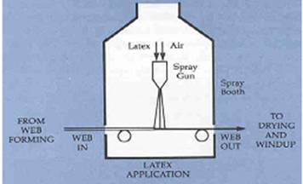
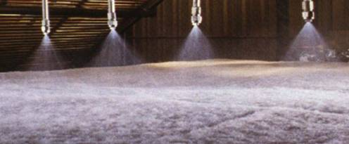
CHEMICAL BONDING
Spray bonding
In spray bonding, binders are sprayed onto moving webs.
Spray bonding is used for fabric applications that which require the maintenance of highloft or bulk, such as fiberfill and air-laid pulp wipes.
The binder is atomized by air pressure, and is applied to the upper surfaces of the web in fine droplet form through a system of nozzles.

Slide 30
TYPES OF BINDERS USED IN CHEMICAL BONDING
Polyvinyl Chloride (PVC): The homopolymer of polyvinyl chloride is a very hard, rigid polymer
Styrene-Butadiene (S/B, SB, or styrene butadiene rubber): These binders have an excellent combination of flexibility and toughness.
Vinyl Acrylics: These binders are more hydrophobic than the straight VAC binders. They provide excellent toughness, flexibility, and better color stability.
Vinyl Acetate (VAC): The vinyl acetate binders are firm.
Styrenated Acrylics: These are tough, hydrophobic binders.
Acrylic: These binders offer the greatest durability, color stability, and dry/wet performance.

Slide 31
Web Bonding Methods
B) Thermal bonding (cohesion bonding)
In thermal bonding the controlled heat is applied for bonding the non woven fabrics.
And this type of bonding is applied to raw materials which are thermoplastic in nature.
Here a low melt fibre or bicomponent fibre is introduced at the web formation stage to perform the binding function later in the process but the web fibre itself can be used.
There are several thermal bonding systems in use:
Calendar bonding.
Through-air thermal bonding.
Drum and blanket systems.
Sonic bonding.

Slide 32
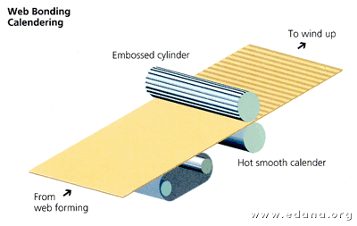
Calender Bonding

Slide 33
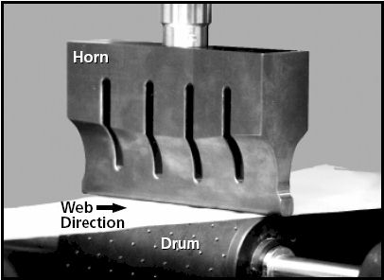
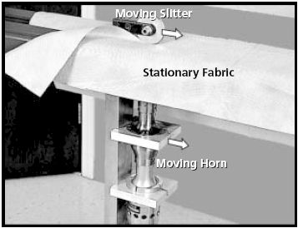
Ultra Sonic Bonding

Slide 34
Web Bonding Methods
C) Mechanical bonding
There are three major types of mechanical bonding:
Needle punching
Hydro-entanglement
Stitch bonding
1) Needle punching
Needle Punching is usually used for manufacturing geo-textiles.
Especially designed needles are hard-pressed and pulled throughout the web to entangle the fibres for proper bonding.

Slide 35
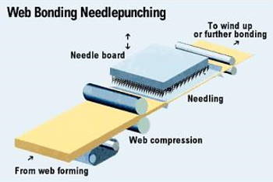
INTRODUCTION TO NEEDLE PUNCHING
The needle punch process is illustrated in fig. Needle punched nonwovens are created by mechanically orienting and interlocking the fibers of a spunbonded or carded web. This mechanical interlocking is achieved with thousands of barbed felting needles repeatedly passing into and out of the web.

Slide 36
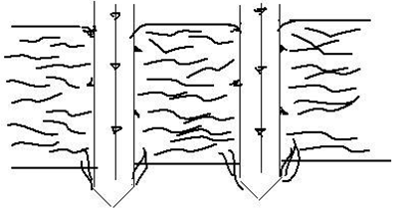
PROCESS OF NEEDLE PUNCHING
Needle punching is carried out passing a number of needles with barbs, mounted in a board, through the batt at a high reciprocating speed.
Needles are arranged in a number of rows (up to 23-26) in a needle board with about 1500 to 5000 needles per 1 m working width.
The needles are usually triangular in cross-section with barbs at the three edges.
As the needle penetrates through the batt, the barbs carry fibres with them thereby causing mechanical entanglement of fibres.
This gives strength and dimensional stability to the batt.

Slide 37
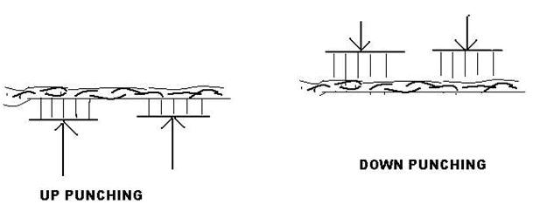
Punch density is dependent upon the number of needles per board, number of boards, stroke frequency and delivery rate.
Stroke frequency is indicated by the number of up and down strokes made by the needle board per min. This is usually 1000 in old machines and has gone up progressively upto 3000 in latest models.
Width of needle punching machine ranges from 2 to 10 m.

Slide 38
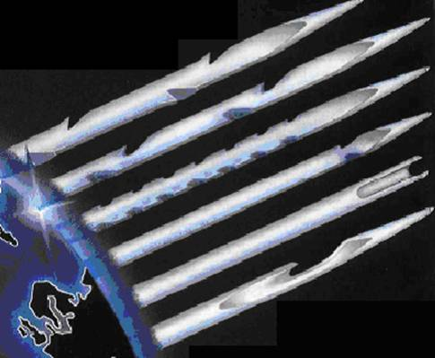
TYPES OF NEEDLES USED IN NEEDLE PUNCHING
Thus finer the needles, higher the punch density. Coarse fibers use the lower punch density, and fine fibers and delicate fibers use the higher punch density. For example, a coarse fiber product may use a 12 to 16 punch density and fine synthetics may use 25 to 40 punch density.

Slide 39
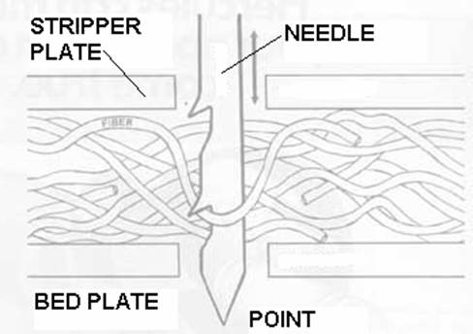
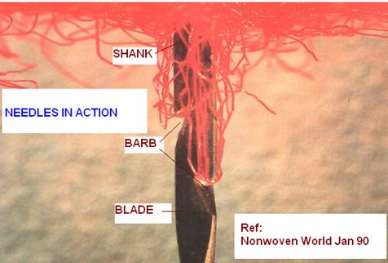
WORKING OF NEEDLES

Slide 40
Web Bonding Methods
C) Mechanical bonding
2) Hydro entanglement
Hydro Entanglement uses high pressure jets of water to cause the fibres to interlace.
It is mainly applied to carded or wet laid webs.
The water jet pressure used has a direct bearing on the strength of the web, but system design also plays a part.
Hydro entanglement is sometimes known as spun lacing.
3) Stitch bonding
Stitch bonding a third type of mechanical bonding.
It can be done with or without the addition of a thread.
When no thread is added, the process is often referred to a loop formation.

Slide 41
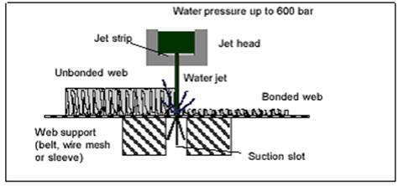
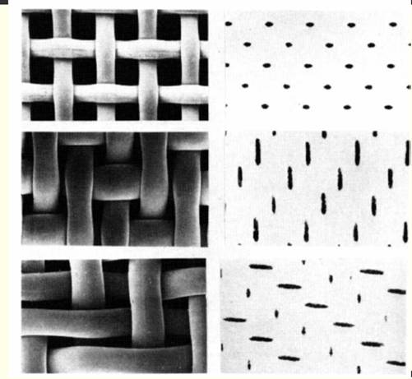
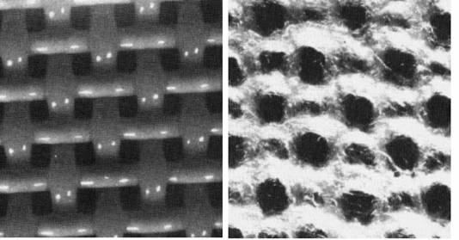
Hydro entanglement
SCENE
3
.

Slide 42
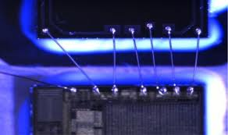
Stitch bonding
Mode of bonding |  | Mass per unit area [g/m2] | Preferable mass/unit area [g/m2]
Thermal | Calendaring | 5–120 | 5–80
 | Thermo fusion | 60–500 | 80–400
Mechanical | Needle-punching | 60–1000 | 100–400
 | STITCH-BONDING | 80–1000 | 100–400
Hydrodynamic |  | 20–400 | 30–200

Slide 43
ADVANTAGES OF NON-WOVEN FABRICS
SCENE
1
Greater strength per basis weight than competing fabrics
2
High levels of uniformity
3
High tear and tensile strength
4
Dimensional stability
5
Consistency in high temperature applications
6
Application-specific engineering.
.

Slide 44
USE OF VARIOUS NON-WOVEN PRODUCTS
Interlining Filter
Used in Garments, Shoes Inners
GSM – 35 to150
Cotton Filters
Used as Pharmaceutical Filters,
Hygienic Filters (Sugar Factory),
Molasis Filtration (Alcohol, Beverages)
GSM – 130 to 400
High Loft Air Filter
Used as special Air Filter
(For Air conditioner)
GSM – 150 to 300
Dust Catchers
Used Mostly in Cement Industry
GSM – 270 to 300
Combustion Filters
Used in Automobile Industry
Geo Textile
Used in Mega Civil Construction
GSM – 200 to 400
Channeling Felt
Used in Window Channeling
Field of Application – Automobiles (Cars/Luxury Interiors), Aero plane Windows
GSM – 530 to 1178
Notes:
44
44

Slide 45
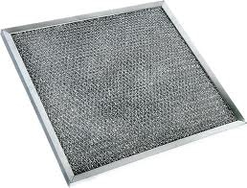
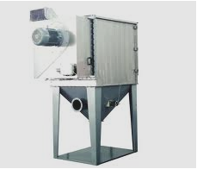
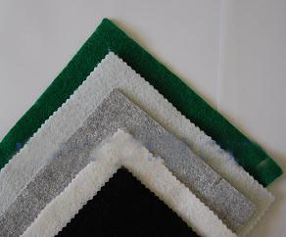
NTERLINING FILTER COTTON FILTERS HIGH LOFT FILTERS
CEMENT DUST CATCHERS GEO-TEXTILES CHANNELING FELT
Notes:
45
45

Slide 46
APPLICATIONS OF NON-WOVEN
Hygiene
baby diapers or nappies
wet wipes
bandages and wound dressings
disposable bath and face towels
disposable slippers and footwear
Medical
isolation gowns
surgical gowns
surgical drapes and covers
surgical scrub suits
caps
medical packaging.
Filters
gasoline, oil and air -filtration
water, coffee, tea bags
pharmceutical industry
mineral processing
liquid cartridge and bag filters
Geotextiles
soil stabilizers and roadway underlayment
foundation stabilizers
erosion control
canals construction
drainage systems
pond and canal water barriers
sand infiltration barrier for drainage tile
Notes:
46
46

Slide 47
APPLICATION OF NONWOVENS
AGRO TEXTILES Agro bags Agro Protective Garments Frost protection covers | MEDICAL TEXTILES Artificial skin Bandages Caps
BUILDING TEXTILES Architectural Composites Awnings Canopies | AUTOMOBILE TEXTILES Auto hose Fabric Boot liners Cabin filters
CLOTHING TEXTILES Clean room garments Interlinings Labels | OEKO TEXTILES Industrial Hazardous waste disposal products Other Oekotech Applications Solid waste disposal Products
GEO TEXTILES Geomembranes Nonwoven Geotextile Other Geotech Applications | PACKAGING TEXTILES FIBC Food packaging fabric Other Packtech Applications
HOME TEXTILES Blanket Blinds Composites | PROTECTIVE TEXTILES Chemical Protection Dust protection fabrics Electrical protective clothing
INDUSTRIAL TEXTILES Abrasives Fabrics Battery separator fabric Cigarette filter | SPORTS TEXTILES Artificial turf Boat cover
Notes:
47
47

Slide 48
References
http://www.technicaltextile.net
http://www.scribd.com/doc/19791954/
http://dc311.4shared.com/doc/Qt7sgN1P/preview.html
http://www.inda.org/
http://en.wikipedia.org/wiki/Nonwoven_fabric

Slide 49
Thank You
Notes:
49
49

