Slide 1
Protech textile.
Presented by:
084050063 Nitin S. Nikam.
074050030 Dattatray D. Padalkar.
074050013 Chirag v. Dhanmeher.

Slide 2
Protech textile: what is protech textile?
Variety of protective clothing for people working in hazardous atmosphere.
The protective fabrics is used for manufacturing protech garments and related belongings for protection from:
Harmful chemical environment,
Extreme temperature environments,
Low visibility,
Ballistic protection, etc.
Defense department is one of the leading consumers of protective textiles.
The end use application of protective textiles in defense consist of the following:-
Bullet proof jackets.
NBC(Nuclear Biological and Chemical) suits.
High altitude clothing
Fire retardant apparel.

Slide 3
Classification Of Protective Textiles:-
1. Ballistic protection clothing-bulletproof jacket.
2. High visibility clothing.
3.High altitude clothing.
4. Fire retardant apparel.
5. Water proof fabric.

Slide 4
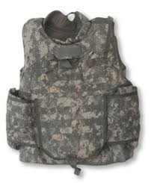
The technical textile products covered under Protech are as given below:-
Bullet proof jacket:-
function:- to resist a bullet.
Based upon the layer principle.
Each layer performs a specific function.
Special protective layers are added,
including a ballistic protection system.

Slide 5
Product characteristics:-
Each jacket weighs about 5 kilograms and is expected to have the following properties:
Light weight.
Comfortable to wear
Facilitate body movement
Ability to spread the projectile energy efficiently.
Each jacket has about 0.6 square meters of non-woven material
weighing around 750 GSM.

Slide 6
Raw materials :- Bullet proof jackets are made from;
Kevlar: High strength with low weight,
High chemical resistance, High cut resistance. Kevlar is also flame resistant; does not melt, soften.
greater protection from bullet due to molecular of fiber.
spectra: These fiber are 10 times stronger then steel.
strong fibers.
Dyneema: It has high energy absorption characteristics. It is very light weight and it can float on water.
4. Twaron: Absorbing a bullet impact and dissipates the energy through adjacent fibers.

Slide 7
Manufacturing of Kevlar and bullet proof jacket:
Kevlar is manufactured by melt spinning machine.
The polymer polyparaphenylene terephthalamide is produced. This is done through a process known as polymerization.
This polymers extruded through a spinneret to form Kevlar yarn.
To make Kevlar cloth, the yarns are woven in the simplest pattern, plain weave.
Manufacturing:
1. Kevlar cloth is sent in large rolls to the bulletproof vest manufacturer.
2. The fabric is first unrolled onto a cutting table.
3. Fibers are wound on the body fabric or Kevlar fabric is placed between the body fabric.
4. The pattern is sewn at the edge with the help of sewing machine.

Slide 8
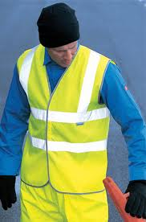
High visibility clothing:
people working in poorly lit environments like mines, highways, airport, runways etc.
In the dark, the high visibility clothing increases the ability to spot working and guiding personnel.

Slide 9
Three types of high visibility clothing material:
1.Photo luminescent material.
2. Fluorescent material.
3.Reflection material.
Characteristics:
light weight.
both night and day visibility.
air and moisture permeability to ensure water comfort.
hemmed edges to durability and neatness.

Slide 10
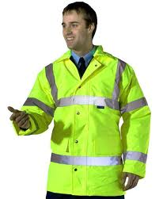
Raw materials:-
The fabric used for high visibility is generally 120gsm fluorescent polyester tricot fabric material with reflective micro prison sheeting.
the reflective tapes are typically 5cm in width,
each piece of vest is require 1.2 to 1.5 sq.mtr of fabric.

Slide 11
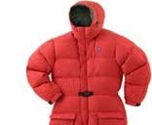
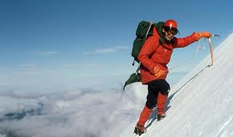
High altitude clothing:
It is used for protection against the extreme weather condition like low temperature, high velocity winds and snow falls.
characteristics of high altitude clothing:
Hydrophilic.
Breathable.
Abrasion resistance.
Maintain high integrity.
Resistance to wear and tear.
total wt. of clothing is 9 to 10 kg.

Slide 12
Raw material:
PTFE
NYLON
The garment is made up of three layers fabric is having PTFE is sandwiched between the two layers of nylon fabric.
Technology :
Weaving
Knitting.

Slide 13
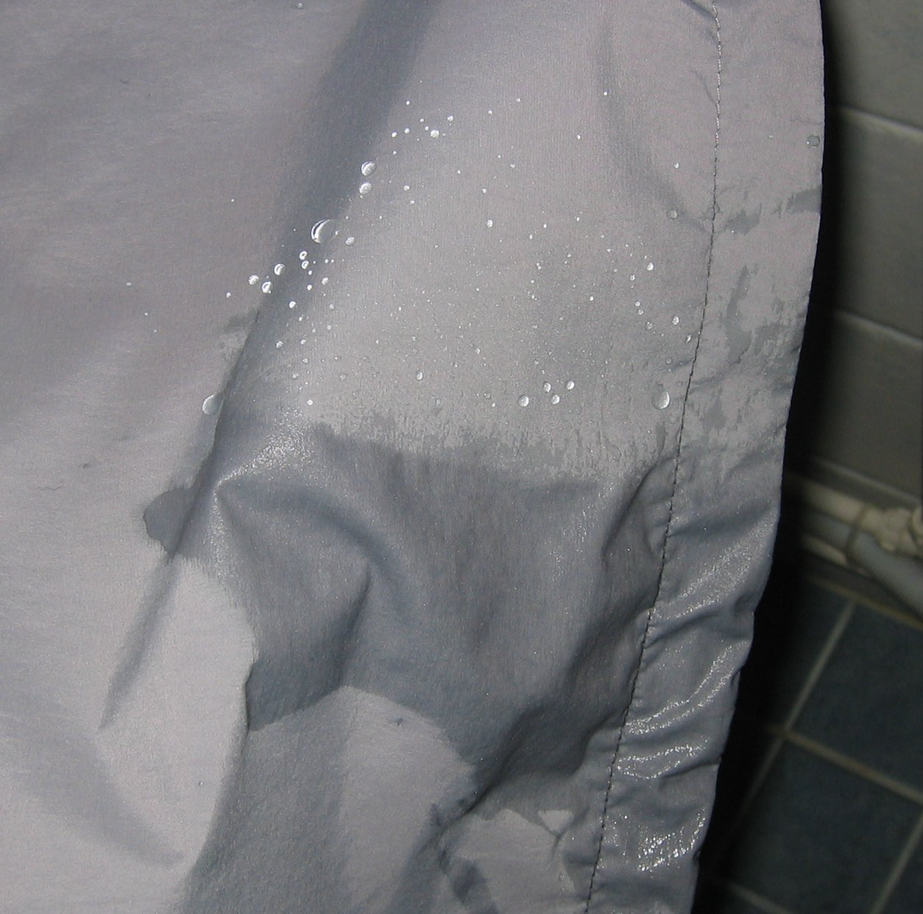
Waterproof breathable fabric

Slide 14
Perspiration activities
clothing has to permit the passage of water vapour
breathability.
It prevent the penetration of liquid water
permits the penetration of water vapour (gas)

Slide 15
How to make a waterproof and breathable fabric
prevent water molecule (liquid) and allow water vapour (gas)
The size of water droplet and the water vapour (gas) and we need to make a fabric with porous space around 10 μm.
In this way, it allows water vapour to pass through (from skin to fabric) and prevent water droplet to penetrate (from outside to fabric).

Slide 16
Types of waterproof breathable fabrics
Densely woven fabric
Membrances
coatings

Slide 17
Densely woven fabrics
first effective waterproof breathable fabric was Ventile.
The yarn is woven using Oxford weave
requiring very high pressure to cause penetration.
waterproof without the need for any water repellent finishing treatment.

Slide 18
Ventile fabric in dry state
Ventile fabric in wet state, closely packed by swelling of cotton fibres

Slide 19
Highly dense woven plain fabric

Slide 20
Membranes
Membranes are extremely thin films made from polymeric material and engineered in such a way that they have a very high resistance to liquid water penetration, yet allow the passage of water vapour.
A typical membranes is only 10 μm thick and is laminated to a conventional textile fabric to provide the necessary mechanical strength.

Slide 21
About fire /flame retardant apparel
1} The fire/flame retardant apparels have an industrial need as they offer protection from fire and other heat intensive tasks.
2}Flame, heat and splashes of molten metal etc. are hazards in many heavy engineering working conditions.
3}The fire retardant apparels are used in refineries, iron and steel plants, aluminum plants and welding industries.

Slide 22
Product characteristics The fire retardant apparels can be manufactured from two varieties of fabric: 1}100% cotton fabric with flame retardant coating or Fabric made of intrinsically flame retardant fibre. 2}The typical characteristics of the apparel are: 3}Flame resistance – must not catch fire 4}Should be breathable 5}Easy to wear 6}Light weight

Slide 23
Should have high abrasion resistance The apparel made from coated fabric generally has a basis weight of 250-350 GSM. The fabric used could be either woven or knitted. The coated fabric which accepted worldwide could have flaws due to incomplete coverage of fire retardant chemical on the fabric surface which would pose threat with aging. The other type of fabric used for flame retardant apparel is a one which is inherently flame retardant.

Slide 24
Following are a few fibre retardant fibres used of this production of apparel: 1}Meta Aramid 2}Para Aramid 3}Modacrylic 4}Polyamide

Slide 25
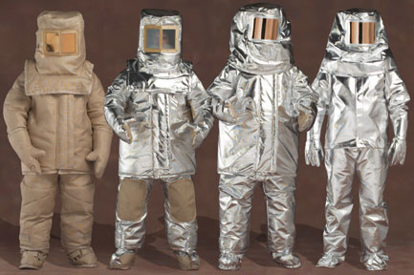
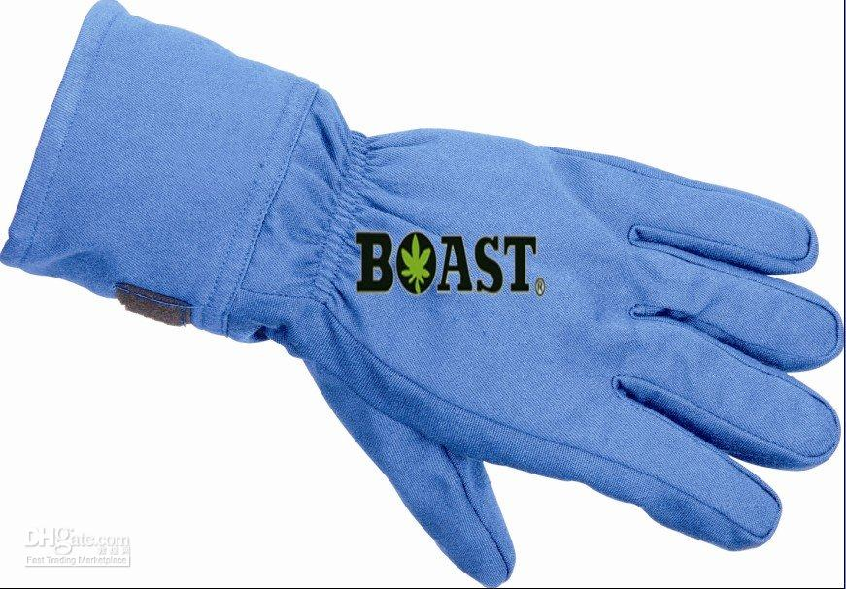

Slide 26
Raw-materials 1}The manufacturing process generally involves cutting the fabric and stitching/sewing the fabric together based on the requirement. 2}The thread used for sewing is also fibre retardant. 3}The threads generally used are – Nomex, Kevlar, Fibreglass, Carbon and Quartz. 4}The work-in-progress apparel is further fixed with reflective tapes and other materials as per the specifications.

Slide 27
Technology used: 1}Weaving 2}Coating

Slide 28
Thank you….

